Slide 1
機器學習第三次報告 Music genre classification.
任課教師: 彭冠舉老師
研究生： 陳奕傑
國立中興大學大數據產學研發班
Jan 8, 2020

Slide 2
Music Genre Classification using
Machine Learning Techniques
Hareesh Bahuleyan
University of Waterloo, ON, Canada
hpallika@uwaterloo.ca

Slide 3
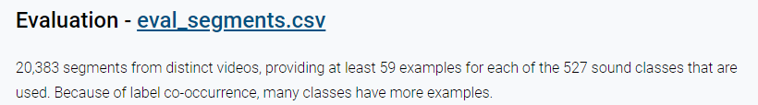
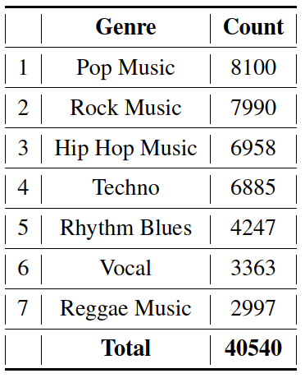
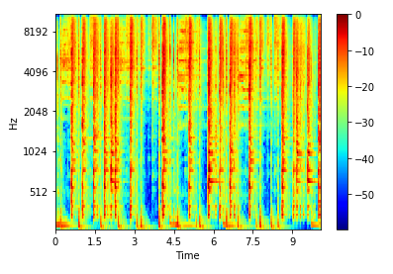
Dataset
Step1. AudioSet: Gemmeke.ate 2017
AudioSet網站中提供了將youtube影片類型標籤化的文件eval_segments.csv。
# YTID, start_seconds, end_seconds, positive_labels
Step2. youtube-dl (Gonzalez, 2006)
透過youtube-dl 下載所需的youtube mp4
Step3. ffmpeg (Tomar, 2006)
mp4 files are converted into the desired wav format
Step4. STFT (librosa)
wav format signal to MEL spectrogram
Notes:
Pop music,Rock music,Hip hop music,Techno,Rhythm Blues,Vocal,Reggae Music
Sampling rate (sr) = 22050
Frame/Window size (n fft) = 2048
Time advance between frames (hop size)= 512 (resulting in 75% overlap)
Window Function: Hann Window
Frequency Scale: MEL
Number of MEL bins: 96
Highest Frequency (f max) = sr/2
stft短时傅里叶变换
梅尔频谱mel spectrogram

Slide 4
step.2
將資料切割為train (90%),validation (5%) and test (5%) sets
step.4
根據transfer learning 以及 fine tuning兩種不同的方式設置。
step.6
利用Accurancy、
F-score評估模型的性能。
step.1
將圖片轉成216*216
step.5
All models were trained for 10 epochs with a batch size of 32 with the ADAM optimizer.。
step.3
導入VGG16模型，並採用已建立好的ImageNet 模型參數。
Notes:
NUM_CLASS=7
1000 class
1.

Slide 5
資料型態
Genre | Final report Count | Paper count
Pop_music | 56 | 8100
Rock_music | 69 | 7990
Hip_hop_music | 50 | 6958
Techno | 58 | 6885
Rhythm_blues | 60 | 4247
Vocal | 60 | 3363
Reggae | 62 | 2997
total | 415 | 40540
將各音樂.wav 擷取前十秒後，利用librosa套件將音樂轉成MEL spectrogram，再丟入vgg-16模型分析!

Slide 6
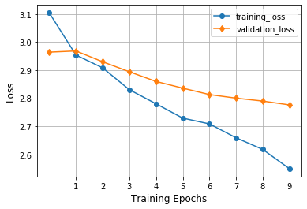
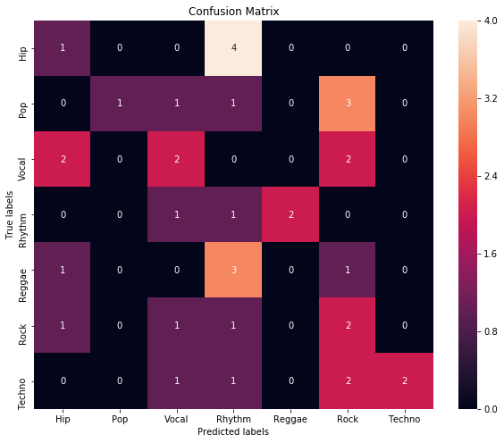
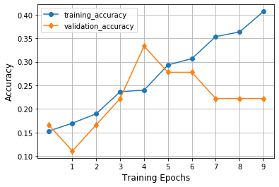
1.transfer learning
Learning Curves - used for model selection; Epoch 4 hashighest validation accuracy。
(a) Loss
Test Set Accuracy = 0.24
Test Set F-score = 0.25
(b) Accuracy

Slide 7
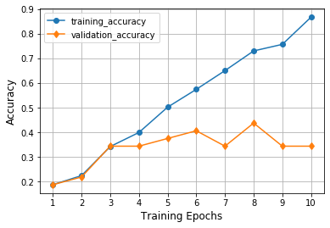
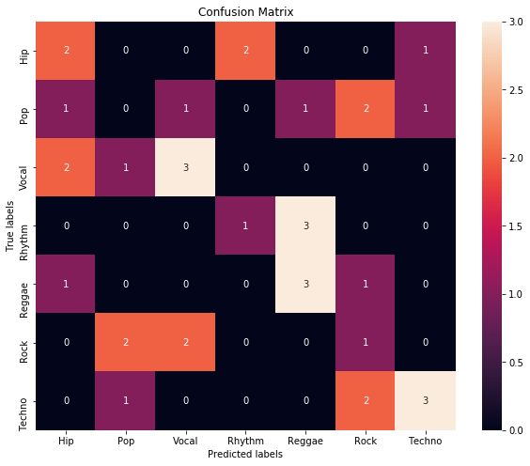
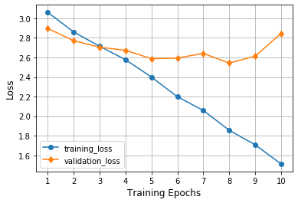
2.fine tuning
Learning Curves - used for model selection;
Epoch 8 has the minimum validation loss and highest validation accuracy。
(a) Loss
Test Set Accuracy = 0.35
Test Set F-score = 0.34
(b) Accuracy

Slide 8
結論:
 | Accuracy | F-score
VGG-16 Transfer Learning(paper) | 0.63 | 0.61
VGG-16 Fine Tuing (paper) | 0.64 | 0.61
VGG-16 Transfer Learning(finalreport) | 0.24 | 0.25
VGG-16 Fine Tuing (finalreport) | 0.35 | 0.34
對於實作後與paper的差別:
1.資料量差太多

Slide 9
Music Genre classification using a hierarchical Long Short Term Memory (LSTM) model
Chun Pui Tang, Ka Long Chui, Ying Kin Yu, Zhiliang Zeng, Kin Hong Wong
Department of Computer Science and Engineering, The Chinese University of Hong Kong
Hong Kong
khwong@cse.cuhk.edu.hk

Slide 10
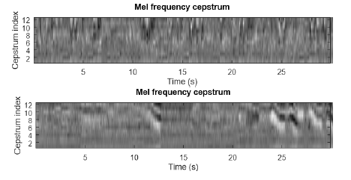
資料型態
Gtzan music dataset
Use the Librosa python Library提取音頻特徵，即MFCC features。
Music Genre | Counts
Blues | 100
Classical | 92
Country | 91
Disco | 92
Hiphop | 82
Jazz | 92
Metal | 100
Pop | 100
Reggae | 100
Rock | 95
Frame size as 25 ms , 30-second has 1293 frames,13 MFCC features!
Data input Lstm for x.shape (849,1293,13)
Val:47,test:48

Slide 11
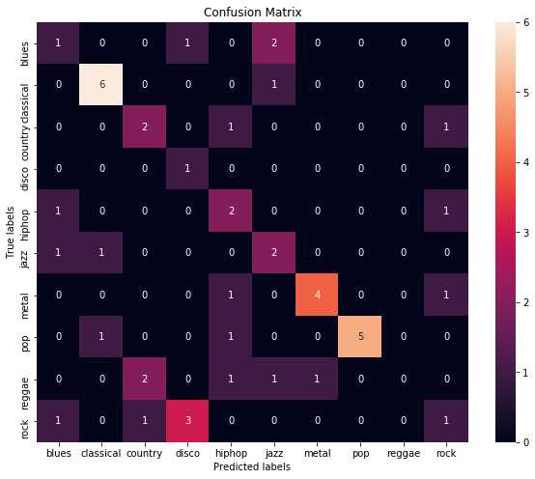
For report
EPOCH:10
Test Set Accuracy = 0.50
Test Set F-score = 0.44
單純將整體資料套用LSTM，想要與後面的方法做比較！

Slide 12
Exp.2 The divide-and-conquer approach for 10-genre classification
LSTM1
LSTM2a
LSTM3a
LSTM3b
LSTM2b
LSTM3c
LSTM3d
Raggae
Rock
Hip-hop
Metal
Pop
Jazz
Country
Dicso
Classic
Blues
LSTM1: It classifies strong and mild music.
LSTM2a: It divides the music into Sub-strong1 and Sub-strong2 classes.
LSTM2b: Sub-mild1 and Sub-mild2 for training.
LSTM3a: It classifies music into hiphop, metal and rock
LSTM3b: It differentiates pop music from reggae
LSTM3c: It differentiates disco music from country.
LSTM3d: It recognizes jazz, classic and blues.
Notes:
LSTM1: It classifies strong (hiphop metal pop rock reggae)
and mild (jazz disco country classic blues) music.
LSTM2a: It divides the music into Sub-strong1 (hiphop, metal
and rock) and Sub-strong2 (pop and reggae) classes.
During training, only music samples of hiphop, metal, rock, pop and
reggae are involved.
• LSTM2b:
It categorizes music into Sub-mild1(disco and country)
and Sub-mild2 (jazz, classic and blues) groups. We used
samples only from of disco, country, jazz, classic and blues
for training.
• LSTM3a: It classifies music into hiphop, metal and rock. Only
music from hiphop, metal and rock class are involved.
• LSTM3b: It differentiates pop music from reggae
• LSTM3c: It differentiates disco music from country.
• LSTM3d: It recognizes jazz, classic and blues.

Slide 13
Exp.2 New The divide-and-conquer approach for 10-genre classification
LSTM1
LSTM2a
LSTM2b
Raggae
Rock
Hip-hop
Metal
Jazz
Country
Dicso
Classic
Blues
Pop
LSTM1: It classifies strong and mild music.
LSTM2a: It divides the music into hiphop, metal ,pop,reggae and rock.
LSTM2b: It divides the music intojazz, classic ,disco ,country and blues.
Notes:
LSTM1: It classifies strong (hiphop metal pop rock reggae)
and mild (jazz disco country classic blues) music.
LSTM2a: It divides the music into Sub-strong1 (hiphop, metal
and rock) and Sub-strong2 (pop and reggae) classes.
During training, only music samples of hiphop, metal, rock, pop and
reggae are involved.
• LSTM2b:
It categorizes music into Sub-mild1(disco and country)
and Sub-mild2 (jazz, classic and blues) groups. We used
samples only from of disco, country, jazz, classic and blues
for training.
• LSTM3a: It classifies music into hiphop, metal and rock. Only
music from hiphop, metal and rock class are involved.
• LSTM3b: It differentiates pop music from reggae
• LSTM3c: It differentiates disco music from country.
• LSTM3d: It recognizes jazz, classic and blues.

Slide 14
結論:
 | paper | report
LSTM1 (strong, mild) | 80.0% | 75%
hiphop, metal, rock | 48.7% | 40%
pop, reggae | 57.45% | 46.67%
disco, country | 50.92% | 16.67%
jazz, classic, blues | 54.84% | 20%
average of above | 52.975% | 30.8%
LSTM for all class EPOCH:10 | none | 50%
Paper:
There are 420 audio tracks in the data set for training, 120 for validation and 60 for testing
Report:
There are 849 audio tracks in the data set for training, 47 for validation and 48 for testing
與paper的差異:
在這裡我抓取的Gtzan music dataset 整體數量與作者的有差，其結果差異可能會因資料的不同。
以及在第二實驗中，我只有做3個LSTM去分類，而在原作者的實驗中則是用7個LSTM去分類!

Slide 15
References
[1] BAHULEYAN, Hareesh. Music genre classification using machine learning techniques. arXiv preprint arXiv:1804.01149, 2018.
[2] TANG, Chun Pui, et al. Music genre classification using a hierarchical long short term memory (LSTM) model. In: Third International Workshop on Pattern Recognition. International Society for Optics and Photonics, 2018. p. 108281B.
Gtzan: http://opihi.cs.uvic.ca/sound/genres.tar.gz

